Slide 1
GridView in Android

Slide 2
What is GridView
A GridView is a type of AdapterView that displays items in a two-dimensional scrolling grid. Items are inserted into this grid layout from a database or from an array. The adapter is used for displaying this data, setAdapter() method is used to join the adapter with GridView. The main function of the adapter in GridView is to fetch data from a database or array and insert each piece of data in an appropriate item that will be displayed in GridView.

Slide 3
XML Attributes of GridView
android:numColumns: This attribute of GridView will be used to decide the number of columns that are to be displayed in Grid.
android:horizontalSpacing: This attribute is used to define the spacing between two columns of GridView.
android:verticalSpacing: This attribute is used to specify the spacing between two rows of GridView.

Slide 4
Example

Slide 5
app > res > layout > Right-Click > Layout Resource file->cardview.xml

Slide 6
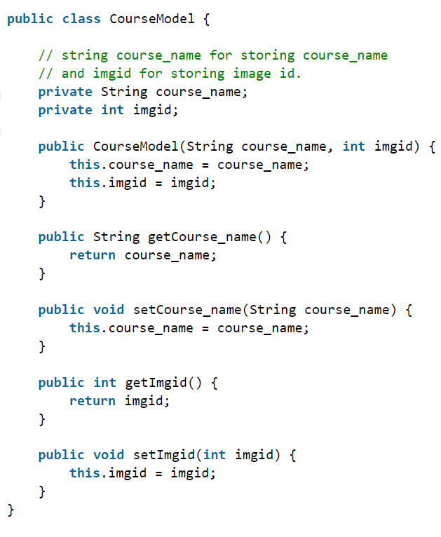
Create a Model Class for Storing Data
app > java > apps package name > Right-Click on it. Then Click on New > Java Class->CourseModel.java

Slide 7
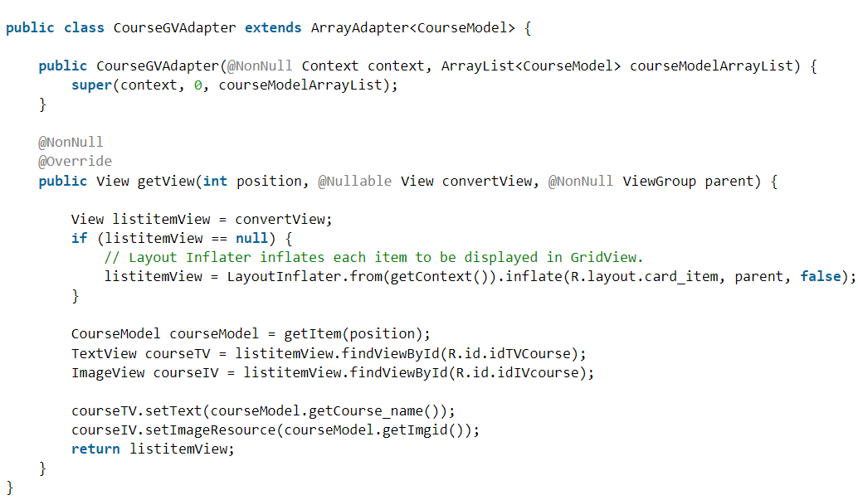
Create an Adapter Class
app > java > apps package name > Right-Click on it. Then Click on New > Java Class->CourseGVadapter.java

Slide 8
Working with the MainActivity File

